Slide 1
Tidy Data for Librarians
July 19, 2022
Julie Vecchio, MPH, MLIS
— nnlm-carpentries.github.io/2022-07-18-ncds-online —
— librarycarpentry.org/lc-spreadsheets —
Notes:
nnlm-carpentries.github.io/2022-07-18-ncds-online
librarycarpentry.org/lc-spreadsheets

Slide 2
Introduction & Agenda
Note: image and icon credits are listed in the speaker notes of this document.

Slide 3



Key Benefits of Tidy Data
Usability / Findability
Error reduction
Efficiency
What else?
Notes:
Find by Adrien Coquet from NounProject.com
Error by ProSymbols from NounProject.com
Productivity by Juicy Fish from NounProject.com

Slide 4



Data Organization
Notes:
Foundational by WEBTECHOPS LLP from NounProject.com
Mountain by ibnu nasikin hasanah from NounProject.com
Foundation by Kukuh Wachyu Bias from NounProject.com

Slide 5



Tidy Data Agenda
Good practices
Common issues
Dates as data
Quality control & assurance
Export considerations
We will NOT cover calculating statistics, plotting, or coding.
Notes:
Find by Adrien Coquet from NounProject.com
Error by ProSymbols from NounProject.com
Calendar Data by Juicy Fish from NounProject.com
Quality Control by KP Arts from NounProject.com
Export by Trevor Dsouza from NounProject.com

Slide 6
Tidy Data Agenda
This session is about foundational ways of thinking
about your data and its organization

Slide 7

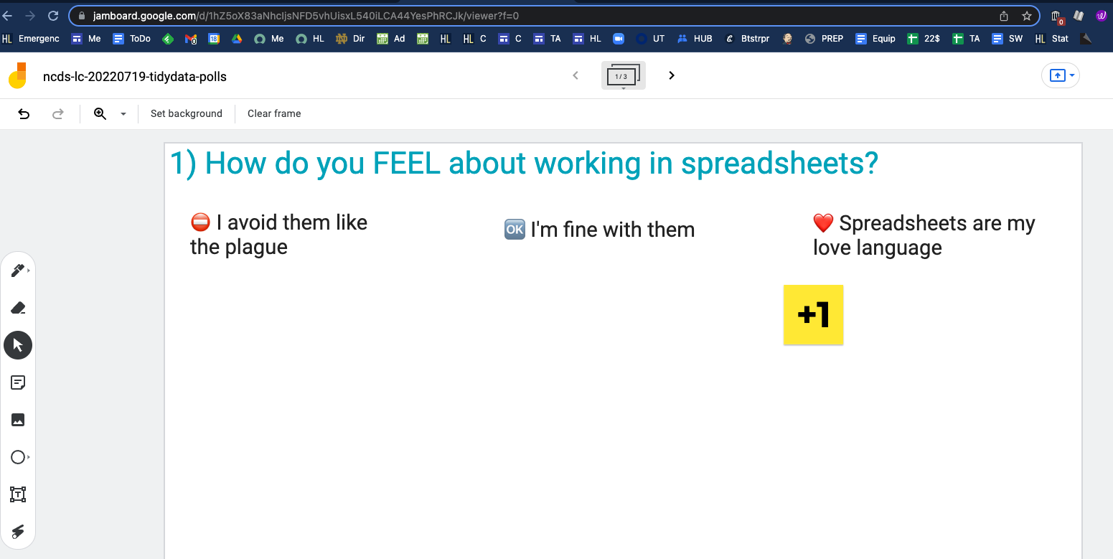
Polls on a Jamboard - 2 minutes -
Please:
tinyurl.com/ncds-lc-tidy-data-polls
Use the sticky note tool to add +1 to your responses to all 3 questions.
Click here to go to the next question
Notes:
Sticky Notes by Guilhem from NounProject.com

Slide 8

Polls on a Jamboard - 2 minutes -
Please:
Go to the Jamboard
Use the sticky note tool to add +1 to your responses to all 3 questions.
Click here to go to the next question
Sticky note tool
Notes:
Sticky Notes by Guilhem from NounProject.com

Slide 9
Poll 1: Right now, how do you feel about working in spreadsheets?
❤️ Spreadsheets are my LOVE language
I’m PRETTY COMFORTABLE with spreadsheets
I’m FINE with spreadsheets
I only work with spreadsheets IF I HAVE TO
⛔ I AVOID spreadsheets like the plague
Other

Slide 10
Poll 2: In the last year, how often did you use spreadsheets for any purpose (entering or reading information) in any context of your life (work, hobby)?
At least daily
At least weekly
At least monthly
At least yearly
Never

Slide 11
Poll 3: In the last year, what kinds of tasks did you perform in a spreadsheet in any context (indicate all that apply)?
Data entry
Data cleaning / wrangling / processing
Data analysis
Data visualization
Sandbox tasks (e.g., calculator, mock-up formatting)
Other

Slide 12
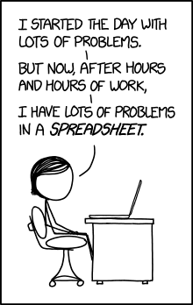
Spreadsheet Challenges
Source: explainxkcd.com/wiki/index.php/1906:_Making_Progress
Notes:
Source: explainxkcd.com/wiki/index.php/1906:_Making_Progress

Slide 13
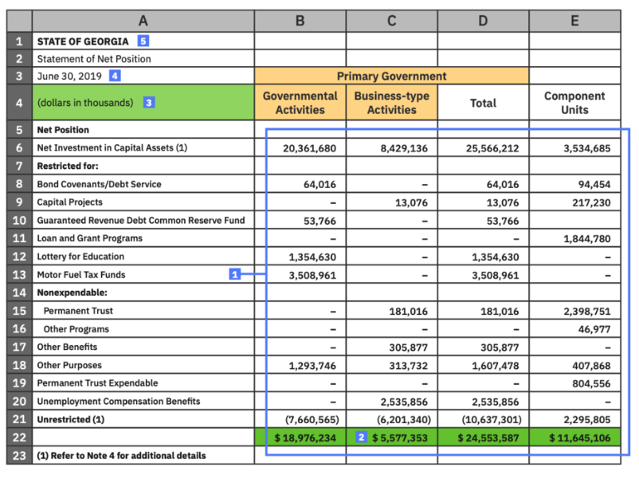
Spreadsheet Challenges
Making spreadsheets look a certain way so that human brains interpret them more easily can make it harder for programs to interpret our data.
Notes:
Source: https://www.datafoundation.org/understanding-machine-readability-in-modern-data-policy-2020

Slide 14
Questions?

Slide 15
Tidy Data Agenda
Good practices
Common issues
Dates as data
Quality control & assurance
Export considerations
We are here!
Notes:
Find by Adrien Coquet from NounProject.com
Error by ProSymbols from NounProject.com
Calendar Data by Juicy Fish from NounProject.com
Quality Control by KP Arts from NounProject.com
Export by Trevor Dsouza from NounProject.com

Slide 16
Data Organization
Notes:
Foundational by WEBTECHOPS LLP from NounProject.com
Mountain by ibnu nasikin hasanah from NounProject.com
Foundation by Kukuh Wachyu Bias from NounProject.com

Slide 17
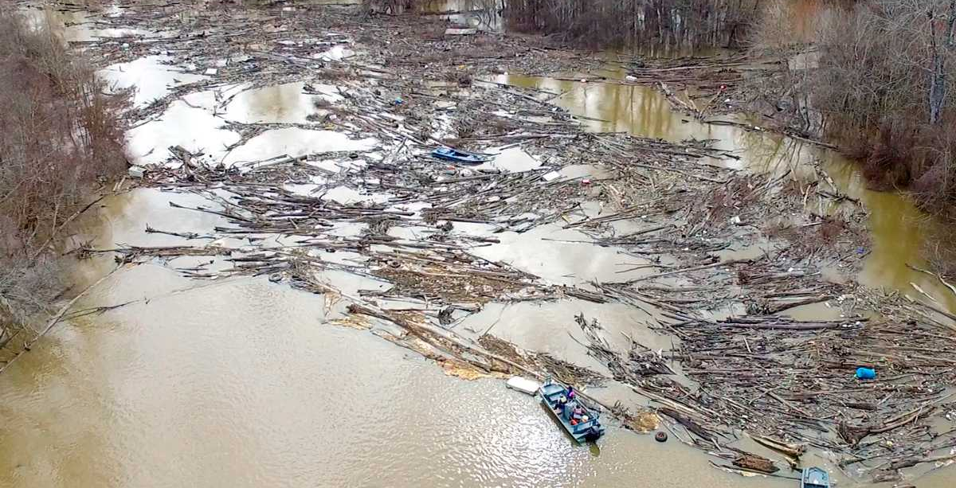
Downstream Issues
Source: https://countryroadsmagazine.com/outdoors/knowing-nature/upstream-downstream/
Notes:
Source: https://countryroadsmagazine.com/outdoors/knowing-nature/upstream-downstream/

Slide 18
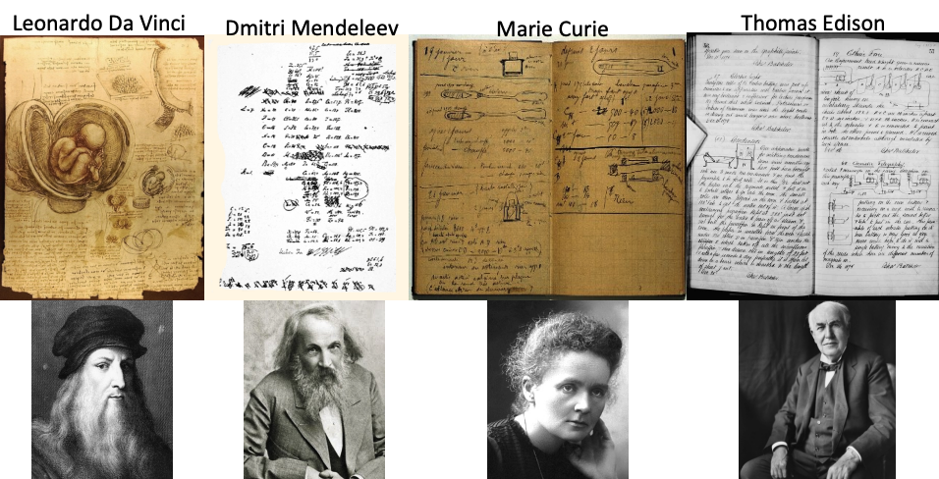
Lab Notebooks
Source: research.columbia.edu/sites/default/files/content/RCT%20content/ReaDI%20Program/tutorial_LabNotebook_V9.pdf
Notes:
Source: research.columbia.edu/sites/default/files/content/RCT%20content/ReaDI%20Program/tutorial_LabNotebook_V9.pdf

Slide 19
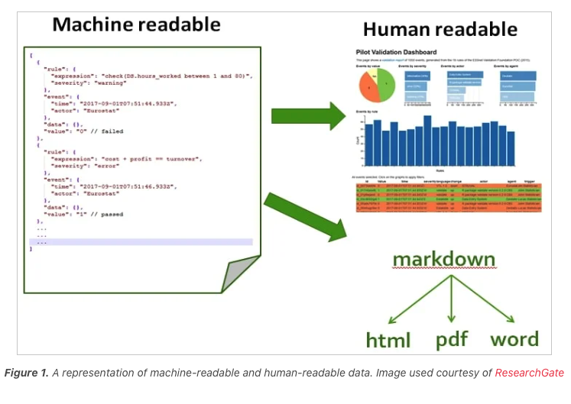
Machine readable versus Human readable
Source: https://control.com/technical-articles/machine-readable-vs-human-readable-data/
Notes:
Source: https://control.com/technical-articles/machine-readable-vs-human-readable-data/

Slide 20



Track Your Steps
Notes:
Workflow by Pablo Rozenberg from NounProject.com
Steps by creacuatro from NounProject.com
Breadcrumb by everydayicoons from NounProject.com

Slide 21

A README is a text file saved in a project’s parent folder that explains the information required to understand a project.
Recommended resource: data.research.cornell.edu/content/readme
Notes:
Source: https://www.makeareadme.com/

Slide 22


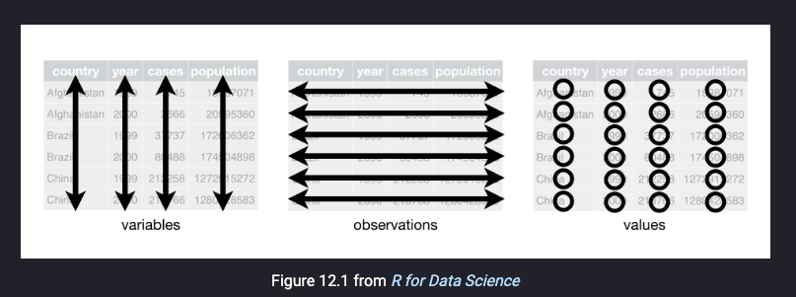
Cardinal Rules of Using Spreadsheet Programs for Data
Your Raw Data
Columns = Variables (e.g., height)
Rows = Observations (e.g., person1)
Cells = Values (don’t combine!)
Leave your raw data alone
Export as text-based format (like CSV)
Notes:
https://www.slideshare.net/GuavaMarkeD/rstats-lessons-for-measure
https://printablesign.net/please-dont-touch-sign-pdf/
https://www.flaticon.com/free-icon/csv-file_4911248

Slide 23

Example
Context:
Attendance at research data management workshops
Different people are entering attendance data in the same file
Cleaning library training attendance data
Notes:
Demonstration by CAMB from NounProject.com

Slide 24
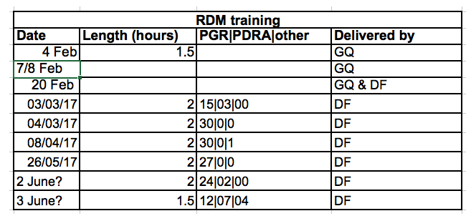
Attendance Data Table: Example—What do you notice?

Slide 25

Hands-On Breakout Room Exercise - 5 minutes -
Please:
Download the data from librarycarpentry.org/lc-spreadsheets/setup.html
Open in any spreadsheet program
Clean the “2016” and “2017” tabs
Combine the data from the 2016 and 2017 tabs into a single tab
We’ll discuss what you did to clean the data
Notes:
Group Discussion by Aneeque Ahmed from NounProject.com

Slide 26
Questions?

Slide 27
Tidy Data Agenda
Good practices
Common issues
Dates as data
Quality control & assurance
Export considerations
We are here!
Notes:
Find by Adrien Coquet from NounProject.com
Error by ProSymbols from NounProject.com
Calendar Data by Juicy Fish from NounProject.com
Quality Control by KP Arts from NounProject.com
Export by Trevor Dsouza from NounProject.com

Slide 28
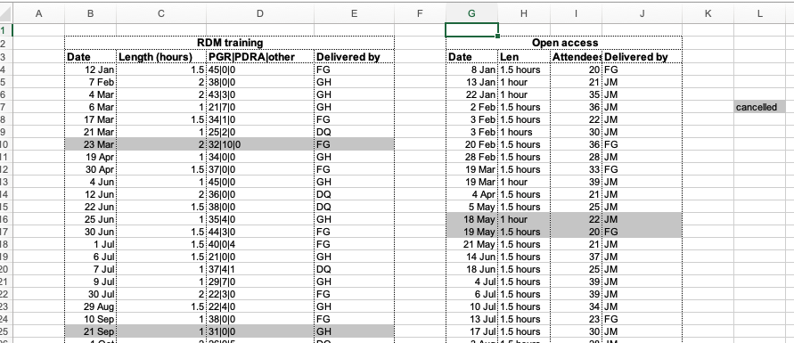
Common Issues: Multiple data tables in one tab

Slide 29
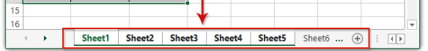

Common Issues: Multiple tabs
Source: https://www.shutterstock.com/image-vector/vector-illustration-broken-links-connections-chain-1431327467
Notes:
Source: https://www.shutterstock.com/image-vector/vector-illustration-broken-links-connections-chain-1431327467

Slide 30

Common Issues: Multiple tabs
“But if I add more columns instead of using tabs, my spreadsheet gets too long!”
Notes:
Attention by Silviu Ojog from NounProject.com

Slide 31

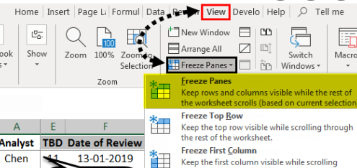
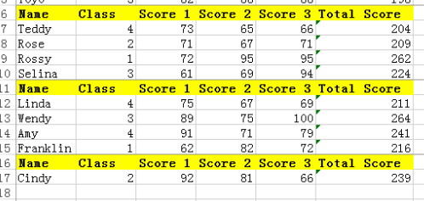
Common Issues: Multiple tabs
“I forgot– I can freeze my column headers!”
“But I will NOT repeat my column headers inside the data table, because that would mix the headers in with my data.”
Notes:
Reply by Icon Picture from NounProject.com

Slide 32

Common Issues: Not filling in zeros
Source: https://royceto.com/should-you-put-zero-or-leave-it-blank-in-your-excel/
Notes:
Source: https://royceto.com/should-you-put-zero-or-leave-it-blank-in-your-excel/

Slide 33
Common Issues: Null values
Context-dependent:
Analysis plans
Statistical software
So it’s important to be:
Thoughtful
Consistent in following through

Slide 34
Common Issues: Null Values
⛔ Do NOT use:
-999
Other numbers
0
✅ Could use:
Blank cell (most applications)
NA or na (for R)

Slide 35
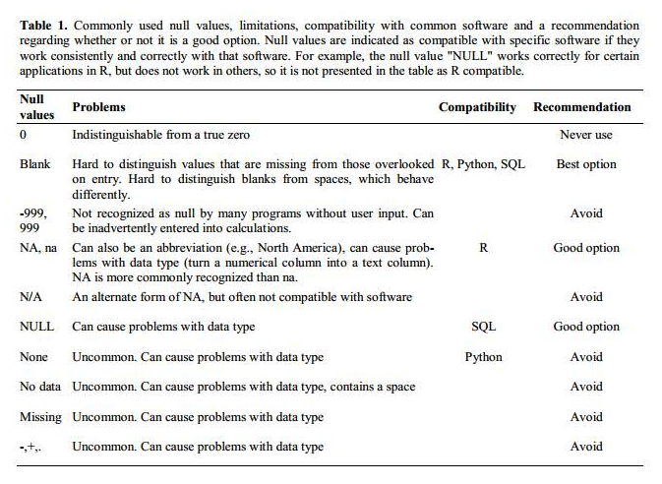
Common Issues: Null values

Slide 36
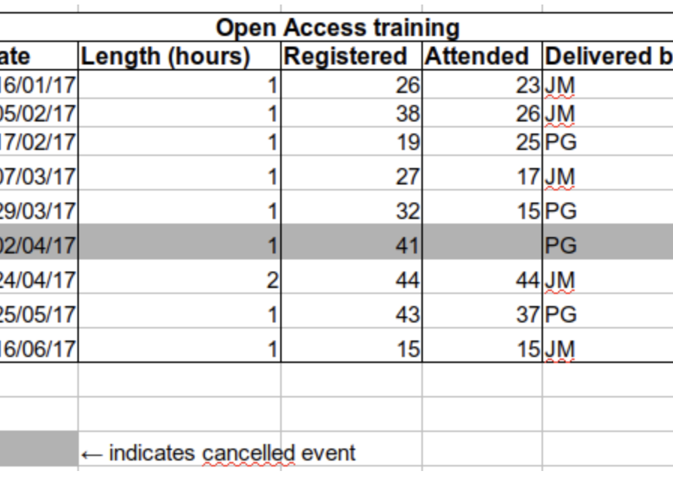
Common Issues: Conveying information only with formatting
⛔ Don’t use formatting as the only means of conveying information!
✅ Instead, encode the information as data!
☝️Then, you can set up conditional formatting if that helps you.

Slide 37
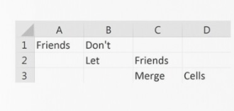
Common Issues: Merging cells for aesthetic purposes
Source: https://www.redbubble.com/i/notebook/Friends-Don-t-Let-Friends-Merge-Cells-by-Schuylerxc/31458689.WX3NH
Notes:
Source: https://www.redbubble.com/i/notebook/Friends-Don-t-Let-Friends-Merge-Cells-by-Schuylerxc/31458689.WX3NH

Slide 38
Common Issues: Placing comments or units in cells

Slide 39
Example
Problem: You discovered the duration data was entered incorrectly by a colleague sometimes. You want to note which values are suspect in the spreadsheet.
What could you do?
Cleaning library training attendance data
Notes:
Demonstration by CAMB from NounProject.com

Slide 40
Common Issues: More than 1 piece of information in a cell

Slide 41
Common Issues: Field names
⛔Avoid:
Spaces
Use underscores _
Use camelCase
Numbers (unless part of proper name related to your variable)
Special characters ($, %, &, etc.)

Slide 42

Common Issues: Field names
✅ Balance description with brevity:
Spaces (instead use underscores _ or camelCase)
Consider including units (e.g., duration_hours)
Abbreviations can be forgotten
Be careful!
Document!
Descriptive
Brief
Notes:
See Saw by Rifai from NounProject.com

Slide 43
Hands-On Jamboard Exercise - 5 minutes -
Please:
tinyurl.com/ndcs-lc-tidy-data-field-names
Use the sticky note tool to propose field names for the prompts.
You can also add a +1 sticky note to existing field name proposals if one you would suggest is already posted.
We’ll discuss some of the final responses
Notes:
Sticky Notes by Guilhem from NounProject.com

Slide 44

Common Issues: Special characters should not be in your data
Note: there are cultural considerations! (e.g., if your textual data has accent marks)
Another way to think about this is: make sure your text is unicode.
Source: https://www.webopedia.com/wp-content/uploads/1996/09/Special-Character.jpeg
Notes:
Source: https://www.webopedia.com/wp-content/uploads/1996/09/Special-Character.jpeg

Slide 45
Common Issues: Metadata should not be IN your data tables
Recording data about your data (“metadata”) is essential!
BUT this information should NOT be in your data tables (e.g., don’t include a legend with units).
This information is not data.
Including this information on your data table can disrupt how computer programs interpret your data.

Slide 46
Common Issues: Metadata should not be IN your data tables

Slide 47
Common Issues: Metadata should not be IN your data tables
Instead, store metadata
In a plain text file
Saved in the same location as your data file
With a name clearly associating it with your data file

Slide 48
Questions?

Slide 49
Tidy Data Agenda
Good practices
Common issues
Dates as data
Quality control & assurance
Export considerations
We are here!
Notes:
Find by Adrien Coquet from NounProject.com
Error by ProSymbols from NounProject.com
Calendar Data by Juicy Fish from NounProject.com
Quality Control by KP Arts from NounProject.com
Export by Trevor Dsouza from NounProject.com

Slide 50



Dates as Data
Source: https://www.bbcgoodfood.com/howto/guide/health-benefits-dates, https://www.gq.com/story/dinner-dates-still-good
Notes:
https://www.bbcgoodfood.com/howto/guide/health-benefits-dates
https://www.gq.com/story/dinner-dates-still-good
Date by Setyo Ari Wibowo from NounProject.com

Slide 51
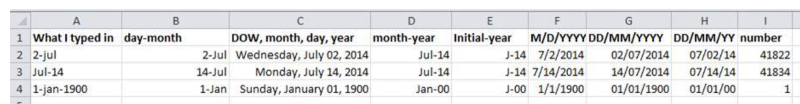
Example
How do the different ways dates are displayed below introduce ambiguity (i.e., make our date information less clear)?
Date display varieties
Notes:
Demonstration by CAMB from NounProject.com

Slide 52
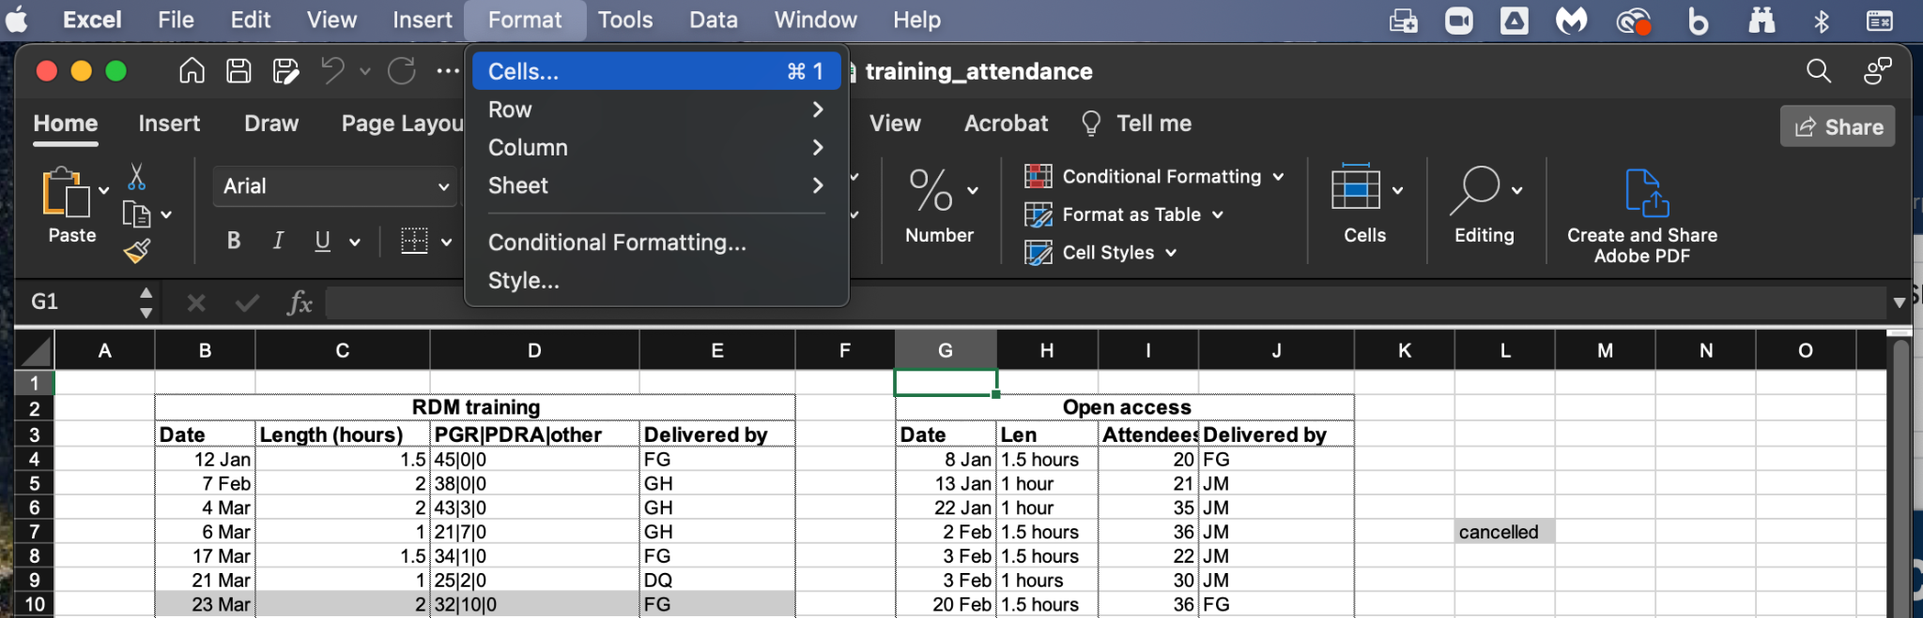
Dates as Data: Excel menu > Format > Cells

Slide 53
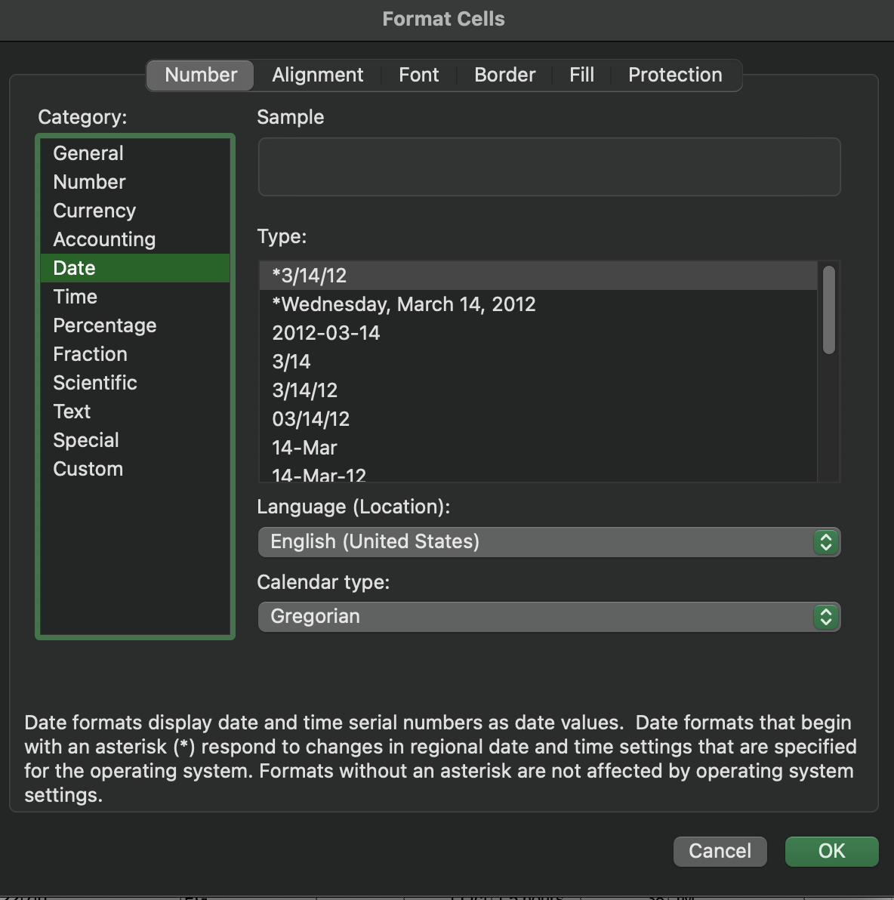
Dates as Data: Excel menu > Format > Cells

Slide 54
Dates as Data: Storing dates
Excel counts the days from a default of Day Zero = December 31, 1899.
E.g., July 2, 2014 is stored as the serial number 41822 because it is 41,822 days after Day Zero.
⚠️ Not all applications or operating systems use the same date for Day Zero.

Slide 55
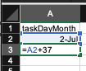
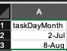
Example
Problem: You need to repeat a task every 37 days and are tired of manually counting task deadlines. What could you do to find out the next date you have to perform the task?
Using Excel to calculate useful date information
Notes:
Demonstration by CAMB from NounProject.com

Slide 56
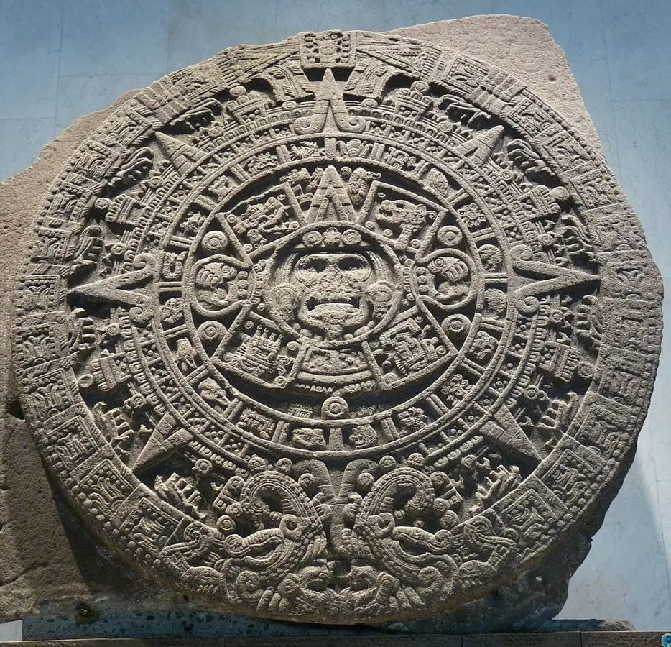
Dates as Data: Dates before 1899-12-31
Excel will not parse dates prior to Day Zero
Excel for Mac uses a different date system (1904 date system)
⚠️ Key takeaway: Know there could be issues with date data!
Source: https://www.calendar.com/history-of-the-calendar/
Notes:
Source: https://www.calendar.com/history-of-the-calendar/

Slide 57
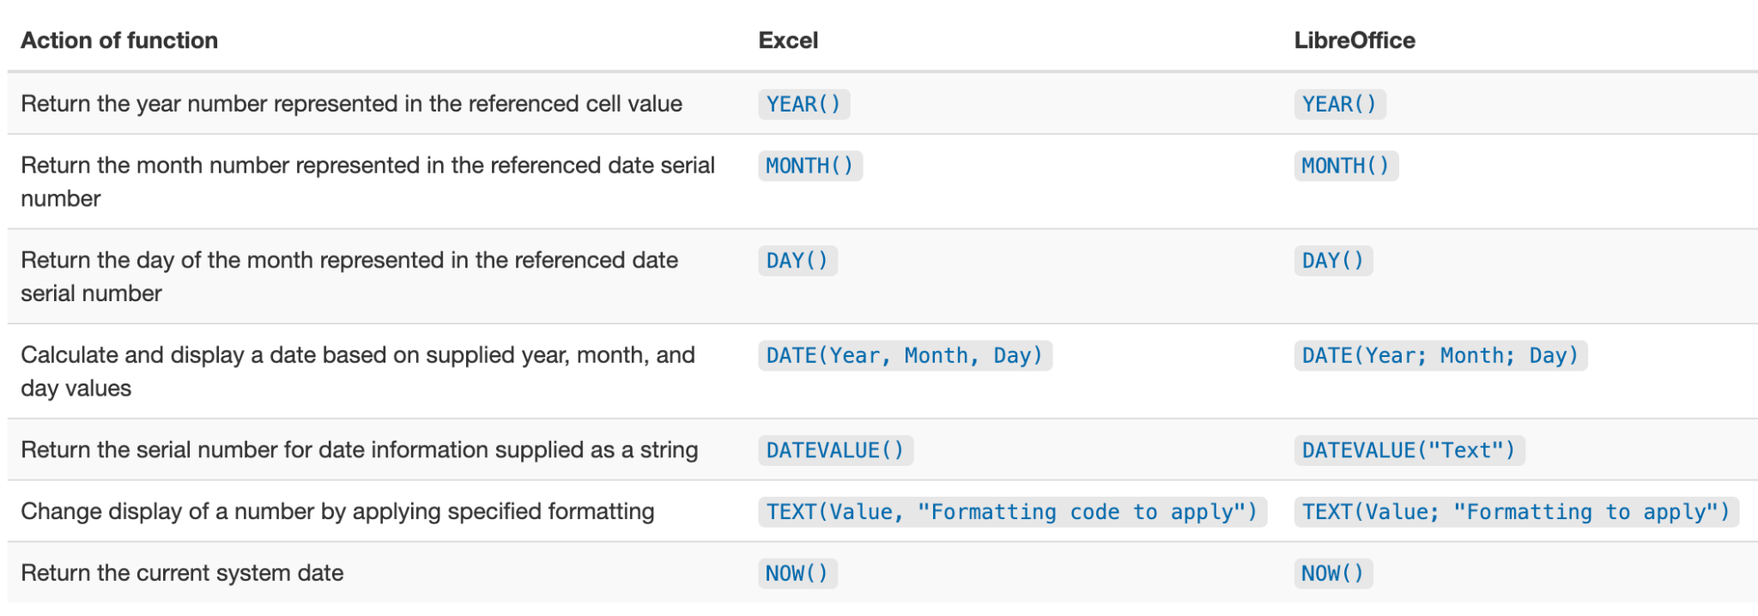
Dates as Data: Useful spreadsheet functions for dates

Slide 58
Hands-On Breakout Room Exercise - 5 minutes -
Please:
Use the “Dates” tab of the dataset
Make 3 new columns that display the year, month, and day data from the date column (A)
Bonus if you have time: Make a new column to display the year, month, and day data you extracted above using the =DATE(Year, Month, Day) function
Plan to let us know how it went!
Notes:
Group Discussion by Aneeque Ahmed from NounProject.com

Slide 59
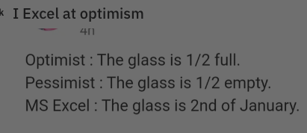
Dates as Data
Source: https://www.reddit.com/r/ProgrammerHumor/comments/ulttdr/i_excel_at_optimism/
Notes:
Source: https://www.reddit.com/r/ProgrammerHumor/comments/ulttdr/i_excel_at_optimism/

Slide 60
Dates as Data: Advantages of alternative date formatting
⚠️ Converting data into different formats can have unintended consequences for our data that have other downstream effects for:
Interoperability (using in other programs)
Sharing
Reuse
Preservation

Slide 61
Dates as Data: Advantages of alternative date formatting
⚠️ Converting data into different formats can have unintended consequences for our data that have other downstream effects for:
Interoperability (using in other programs)
Sharing
Reuse
Preservation
✅ Alternative date formats can help address these concerns!

Slide 62
Example
Save as CSV
Open CSV in Excel
Open CSV in TextEdit
What happened to our date data?
Data conversion can affect date data (aka, why we should consider the advantages of alternative date formatting!)
Notes:
Demonstration by CAMB from NounProject.com

Slide 63
Dates as Data: Advantages of alternative date formatting
Option 1: Year, Month, Day
You can always keep human-readable date values in a column in your data…
But breaking the date into YYYY MM DD component values acts as a safeguard.

Slide 64
Dates as Data: Advantages of alternative date formatting
Option 1: Year, Month, Day
Option 2: Year, Day of Year (e.g., July 2, 2014’s Day of Year is 183)

Slide 65

Dates as Data: Advantages of alternative date formatting
Option 1: Year, Month, Day
Option 2: Year, Day of Year (e.g., July 2, 2014’s Day of Year is 183)
Option 3: ISO 8601 single string YYYYMMDDhhmmss (e.g., March 24, 2015 17:25:35 = 20150324172535 or 2015-03-24-17:25:35)
Use alternative date formats to create safeguards for your data quality!
Notes:
Quality Data by Juicy Fish from NounProject.com

Slide 66
Questions?

Slide 67
Tidy Data Agenda
Good practices
Common issues
Dates as data
Quality control & assurance
Export considerations
We are here!
Notes:
Find by Adrien Coquet from NounProject.com
Error by ProSymbols from NounProject.com
Calendar Data by Juicy Fish from NounProject.com
Quality Control by KP Arts from NounProject.com
Export by Trevor Dsouza from NounProject.com

Slide 68


Quality Assurance (QA) and Control (QC)
Quality assurance:
Goal: PREVENTION–stop incorrect data from being entered
Example: only allow certain types of values of data via drop-down fields
Quality control:
Goal: CORRECTION–find errors after data has been entered
Example: sorting, conditional formatting
Notes:
Prevented Laptop by arejoenah from NounProject.com
Data Fix by Llisole from NounProject.com

Slide 69
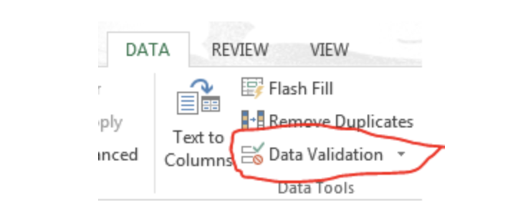
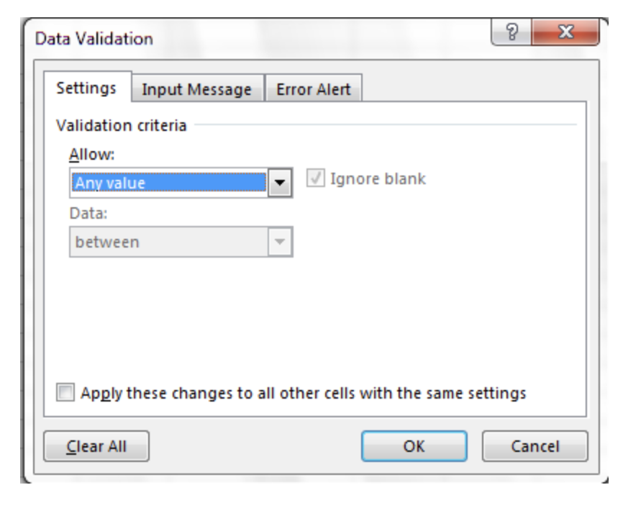
Example
Quality assurance: using “data validation” features in spreadsheet programs
Notes:
Demonstration by CAMB from NounProject.com

Slide 70
QA & QC: Quality control in spreadsheet programs
We should be careful entering this phase of data work–e.g., if we have formulas that reference other cells, we want to make sure that when we are doing QC tasks/moving cells around we aren’t accidentally changing our data!

Slide 71
QA & QC: Quality control in spreadsheet programs
We should be careful entering this phase of data work–e.g., if we have formulas that reference other cells, we want to make sure that when we are doing QC tasks/moving cells around we aren’t accidentally changing our data!
Step 1: Save the original file with a name indicating it is the original data–and then do not change this file!

Slide 72
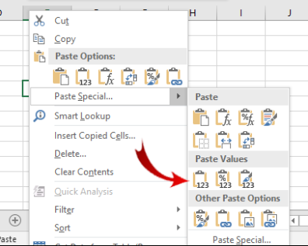
QA & QC: Quality control in spreadsheet programs
We should be careful entering this phase of data work–e.g., if we have formulas that reference other cells, we want to make sure that when we are doing QC tasks/moving cells around we aren’t accidentally changing our data!
Step 1: Save the original file with a name indicating it is the original data–and then do not change this file!
Step 2: Create a separate file for QC work, ensuring the data are stored as VALUES (not as formulas).
Option 1: Copy and paste
Option 2: Use a VBA macro

Slide 73
Example
Please:
Use the “Dates” tab of the dataset
Data > Sort > (Expand the Selection if the box pops up) > Sort by > len_hours > Values > Largest to Smallest > OK
What happens?
Quality control: sorting
Notes:
Demonstration by CAMB from NounProject.com

Slide 74
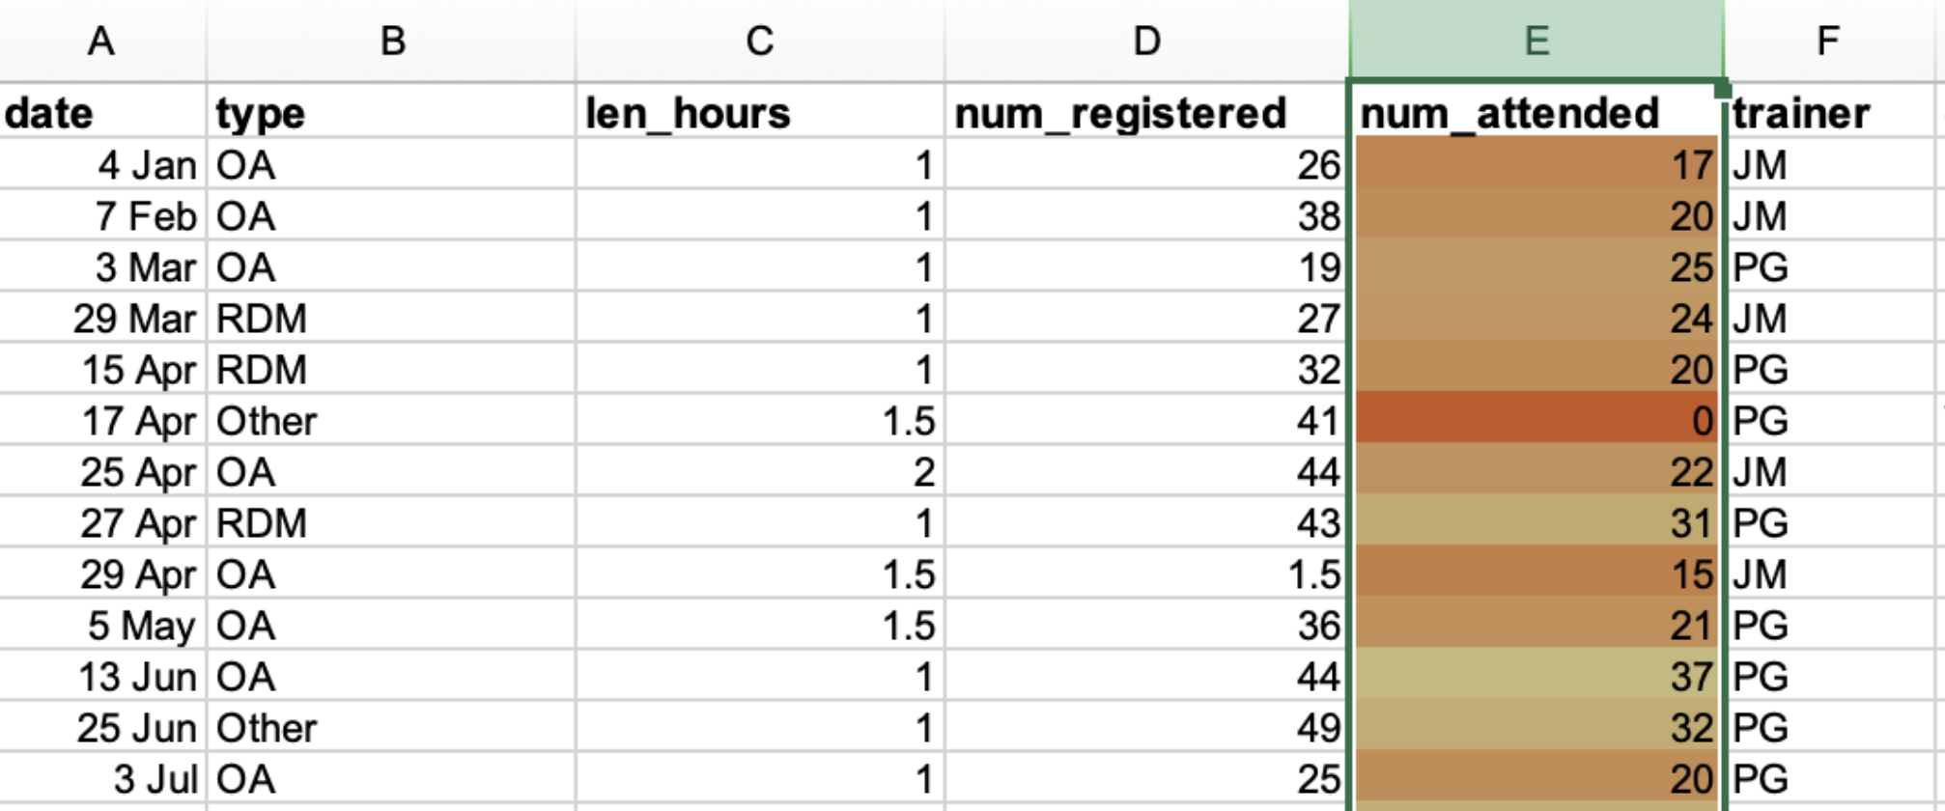
QA & QC: Conditional formatting
Conditional formatting uses your data values to apply formatting changes.

Slide 75
Example
Please:
Use the “Dates” tab of the dataset
Highlight the num_attended column
Format > Conditional Formatting > + > Style: apply any 2-Color Scale rule > OK
What do you notice?
Quality control: conditional formatting
Notes:
Demonstration by CAMB from NounProject.com

Slide 76
Questions?

Slide 77
Tidy Data Agenda
Good practices
Common issues
Dates as data
Quality control & assurance
Export considerations
We are here!
Notes:
Find by Adrien Coquet from NounProject.com
Error by ProSymbols from NounProject.com
Calendar Data by Juicy Fish from NounProject.com
Quality Control by KP Arts from NounProject.com
Export by Trevor Dsouza from NounProject.com

Slide 78
Export Considerations: “Yes, and” your files
It’s not bad to have Excel files, but you should ALSO have your data stored in another format.

Slide 79

Export Considerations: “Yes, and” your files
It’s not bad to have Excel files, but you should ALSO have your data stored in another format.
We may want to open our data in other programs
We may not have Excel in the future
We may have a different version of Excel (which handle data differently!)
Source: https://www.versionmuseum.com/history-of/microsoft-excel
Notes:
Source: https://www.versionmuseum.com/history-of/microsoft-excel

Slide 80
Export Considerations: Save your data file in a universal, open, static file format (CSV)
Excel:
Binary file that holds information about all the tabs/sheets in a file
Proprietary program–not able to be opened in many other programs
Even if you have Excel available to you, different versions of Excel may handle data differently
CSV:
Plain text format with a series of values separated by commas
Can be opened in any text editor program (Excel, TextEdit, etc.)
⭐ Maximum portability + maximum endurance

Slide 81
Export Considerations: Cross-platform operability
Most coding and statistical environments expect UNIX-style line endings (LF)
Windows uses a different ending (CR LF) (because of old teletype systems!)

Slide 82
Export Considerations: Cross-platform operability
Most coding and statistical environments expect UNIX-style line endings (LF)
Windows uses a different ending (CR LF)
So, exporting to CSV using Excel, your data will look like this: data1,data2<CR><LF>1,2<CR><LF>4,5<CR><LF>

Slide 83
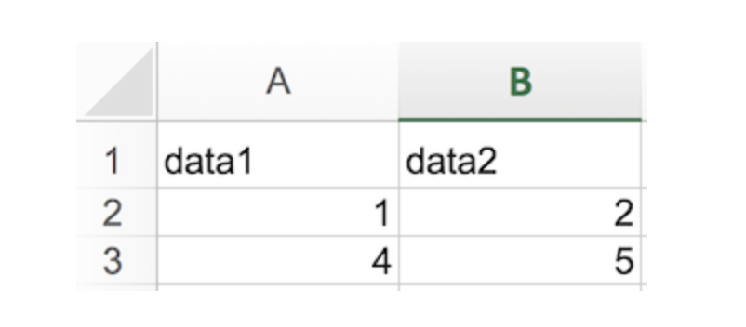
Export Considerations: Cross-platform operability
Exporting to CSV using Excel, the data in text format will look like this: data1,data2<CR><LF>1,2<CR><LF>4,5<CR><LF>
Opening the CSV in Excel will look like this:

Slide 84
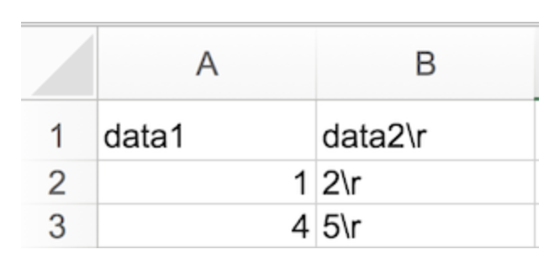
Export Considerations: Cross-platform operability
Opening our data in a system that doesn’t parse the CR character will show the data in text format like this: data1,data2<CR> 1,2<CR>
And in table format it will look like this

Slide 85
Export Considerations: Cross-platform operability
When exporting from Excel, save as a “Windows CSV file”

Slide 86
Export Considerations: Commas
If your data have commas, be aware and careful!

Slide 87
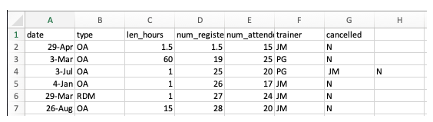
Export Considerations: Commas
If your data have commas, be aware and careful! e.g.,
date,type,len_hours,num_registered,num_attended,trainer,cancelled
29 Apr,OA,1.5,1.5,15,JM,N
3 Mar,OA,60,19,25,PG,N
3 Jul,OA,1,25,20,PG, JM ,N
4 Jan,OA,1,26,17,JM,N
29 Mar,RDM,1,27,24,JM,N

Slide 88
Final Thoughts: Data organization is foundational to data work!
Data Organization
Notes:
Foundational by WEBTECHOPS LLP from NounProject.com
Mountain by ibnu nasikin hasanah from NounProject.com
Foundation by Kukuh Wachyu Bias from NounProject.com

Slide 89
Final Thoughts: Follow the cardinal rules of working with data!
Your Raw Data
Columns = Variables (e.g., height)
Rows = Observations (e.g., person1)
Cells = Values (don’t combine!)
Leave your raw data alone
Export as text-based format (like CSV)
Notes:
https://www.slideshare.net/GuavaMarkeD/rstats-lessons-for-measure
https://printablesign.net/please-dont-touch-sign-pdf/
https://www.flaticon.com/free-icon/csv-file_4911248

Slide 90
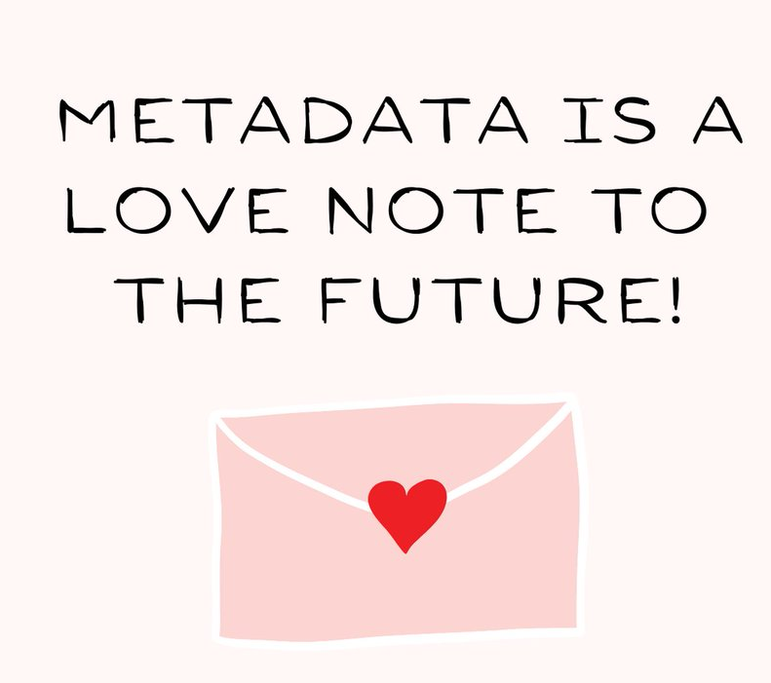
Final Thoughts: Document your data work!
Notes:
Steps by creacuatro from NounProject.com
Source: https://www.makeareadme.com/
https://twitter.com/hlrdmp/status/1360263673848168448

Slide 91
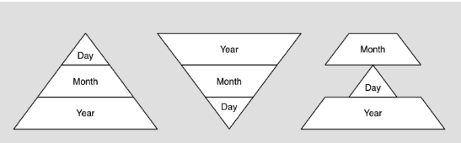
Final Thoughts: Use preferred date formatting (YYYYMMDD)!
Notes:
Source: https://www.gevshop.com/?product_id=275731943_35

Slide 92

Final Thoughts: Leverage tools to prevent data entry errors and make corrections
Notes:
Prevented Laptop by arejoenah from NounProject.com
Data Fix by Llisole from NounProject.com
https://pharmacy.uiowa.edu/event/76501/0

